Slide 1
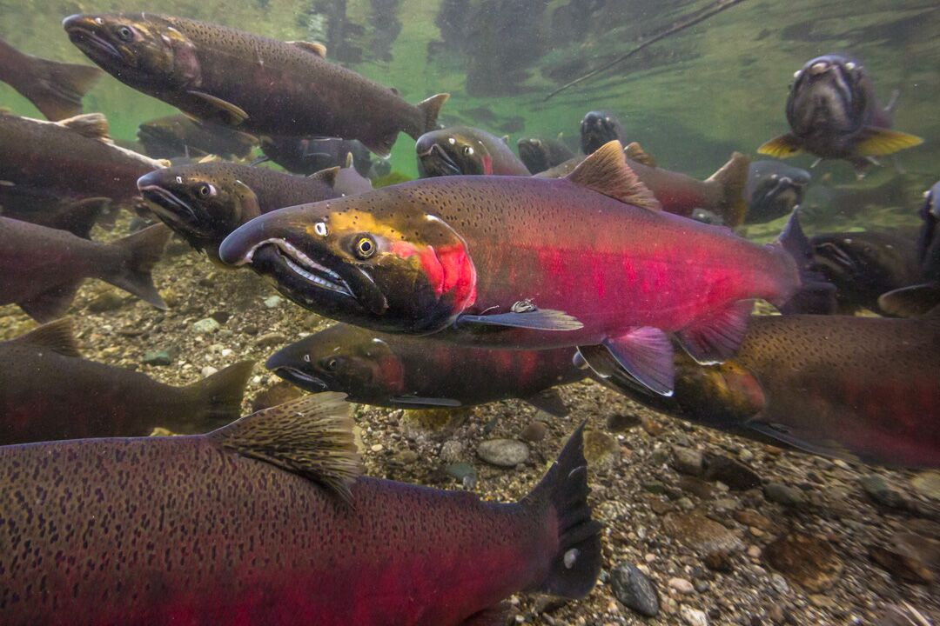
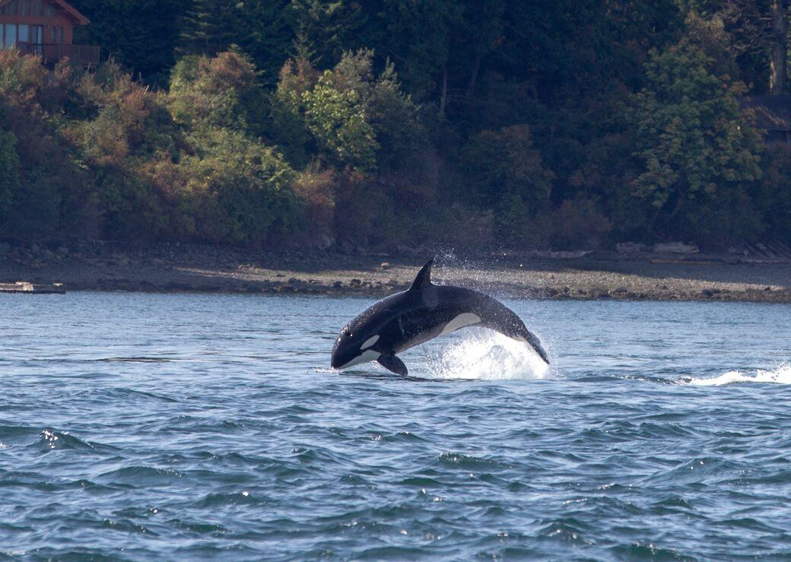
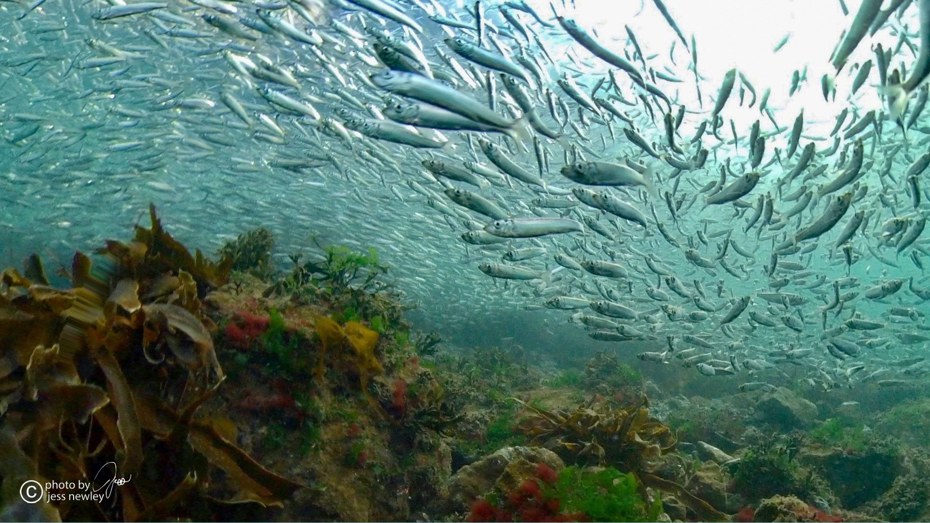
Explore the marine food web
Photo: Jess Newley
Photo: Jess Newley
Photo: Jess Newley

Slide 2
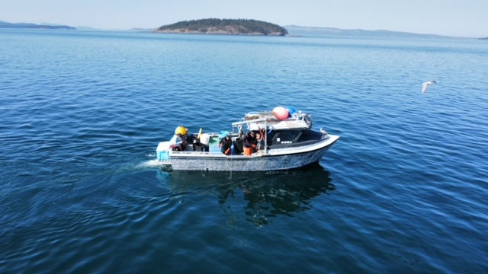
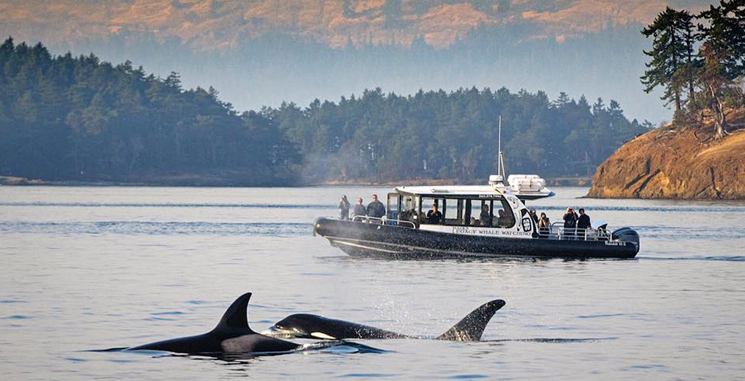
Our Marine Food web
Recreational
Photo: Jess Newley
Economic
Cultural
Photo: Maya Legacy Whale Watching
Notes:
A healthy marine food web in the Salish Sea is important for many reasons, including recreationally, economically, and culturally.

Slide 3
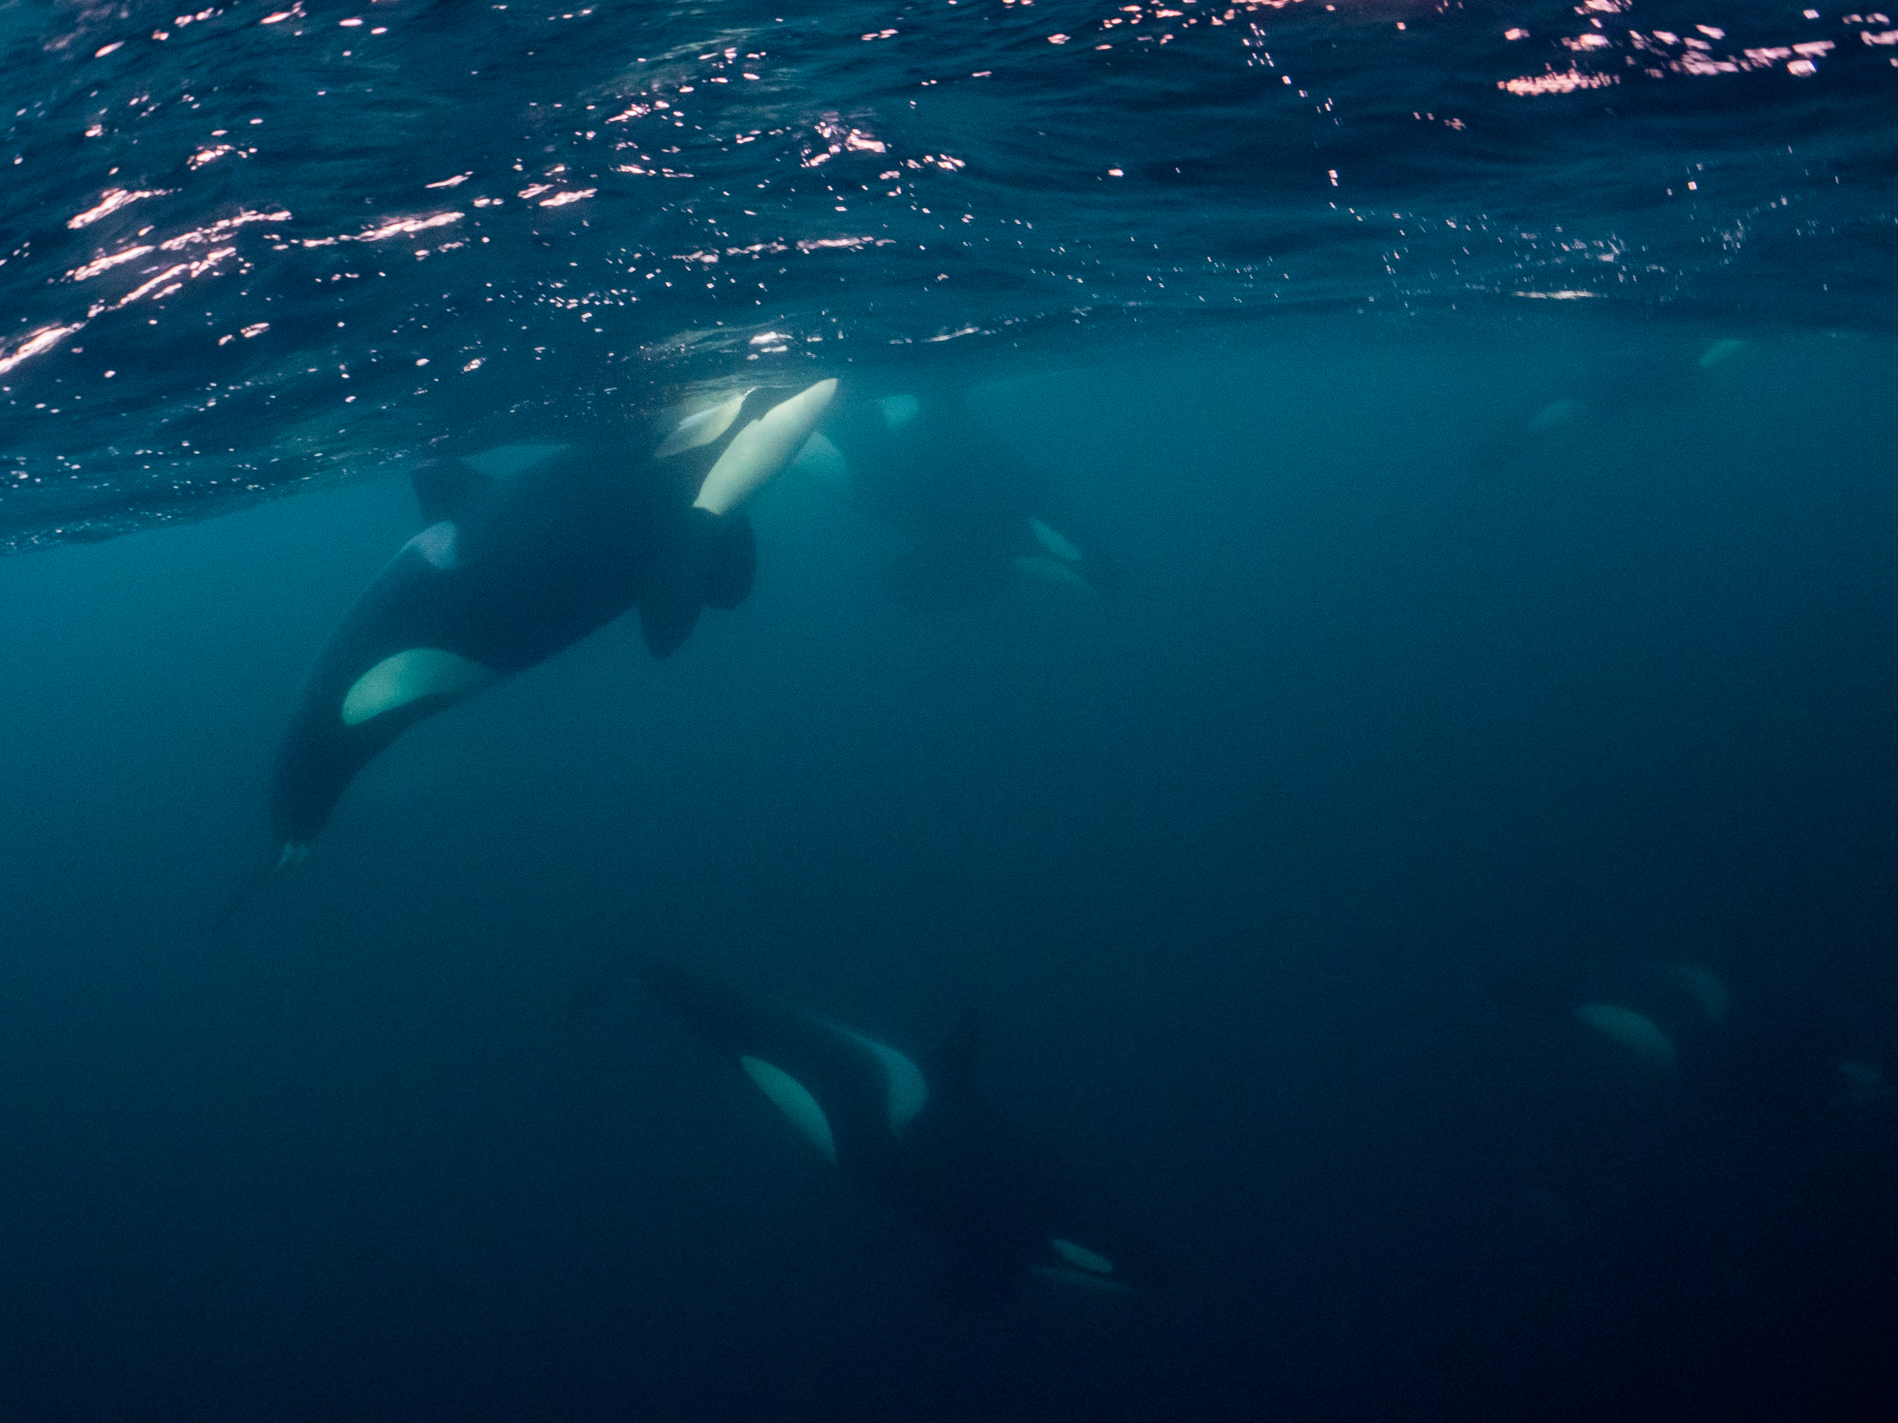
Orca whales
Photo: Jess Newley
Notes:
At the top of the food chain, or the largest predator in the food web, are the killer whales of the Salish Sea. There are 2 eco types of killer whales here and they are the Transient or Bigg’s killer whales who eat marine mammals and the Southern Resident killer whales who eat salmon.

Slide 4
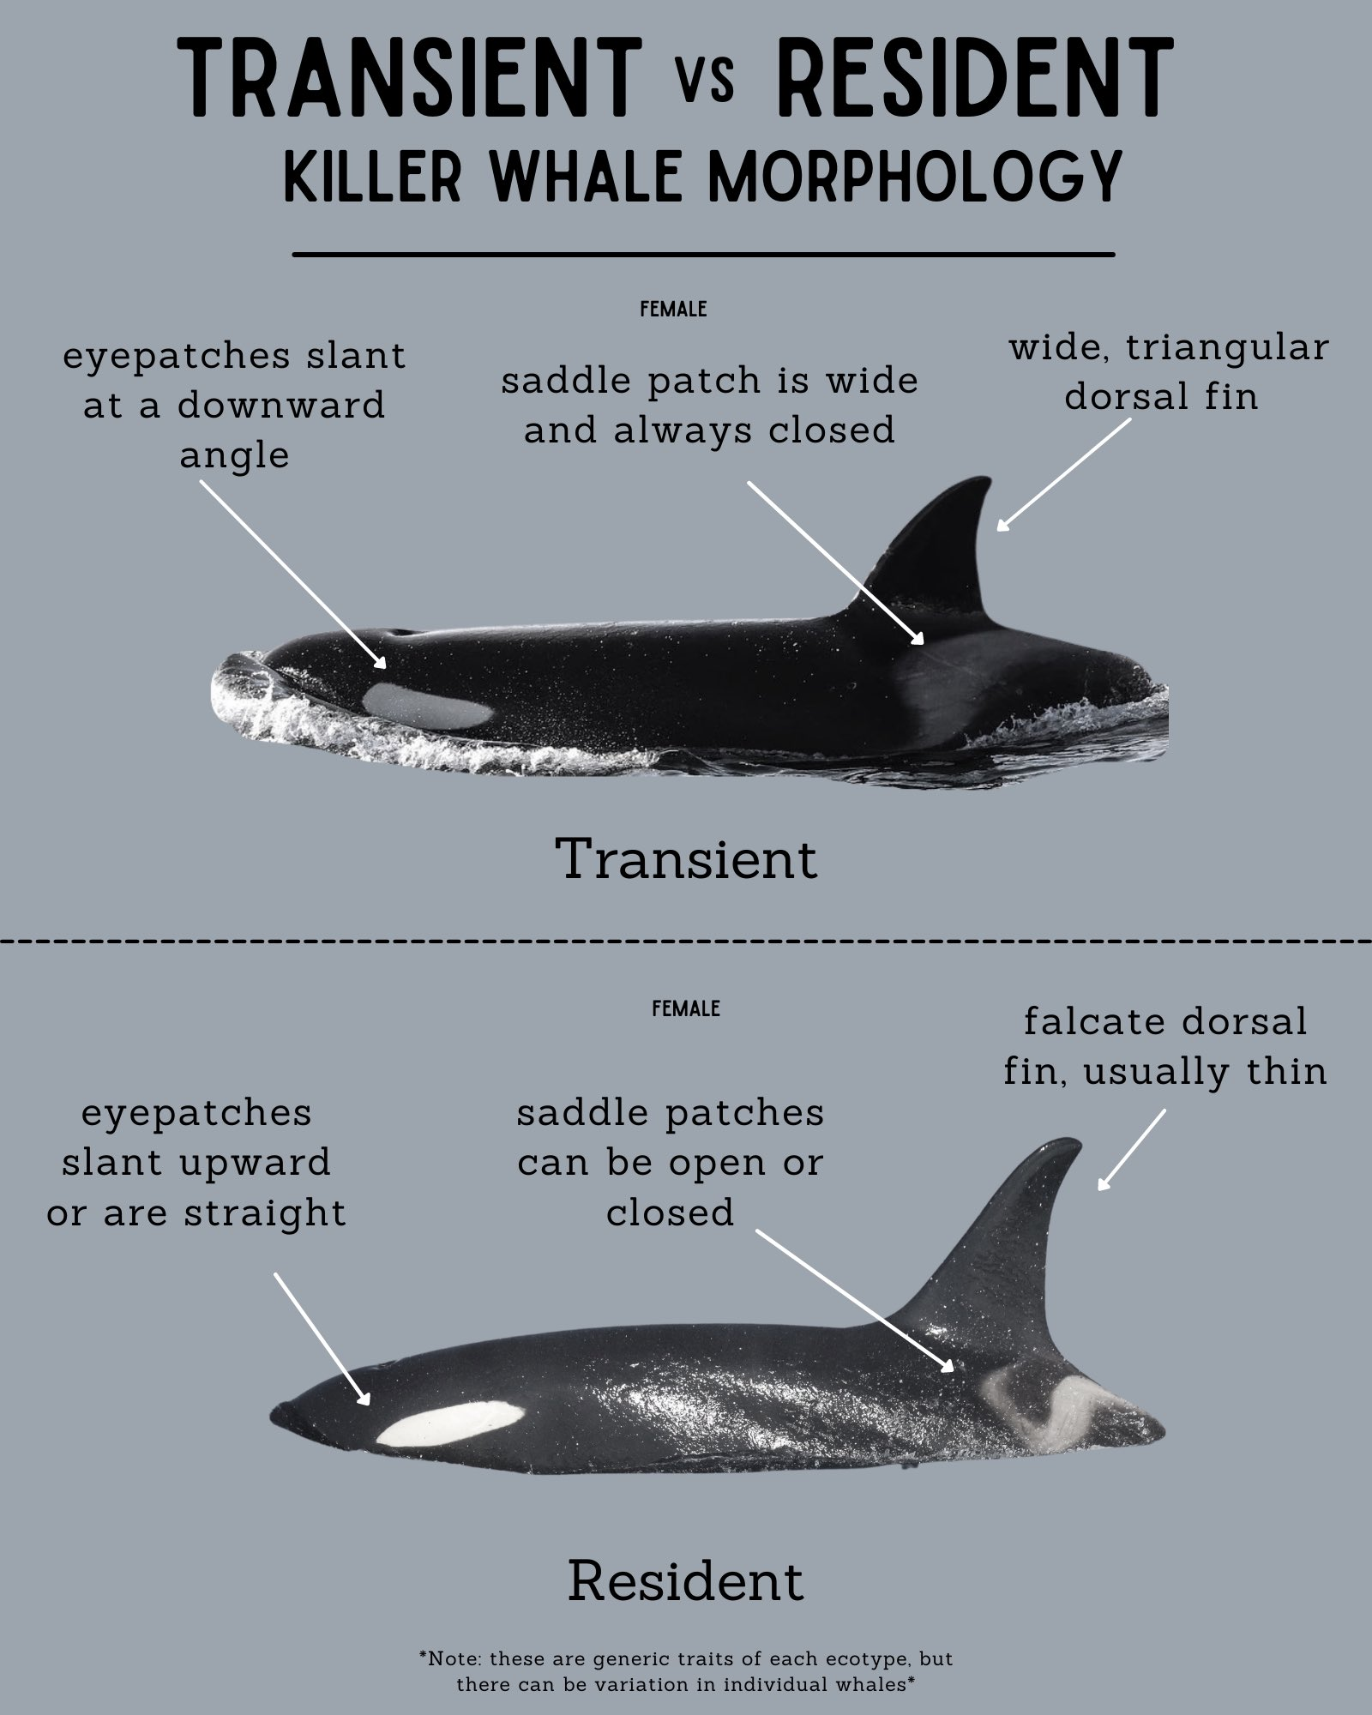
How to tell the difference
Notes:
It can be difficult to tell the difference between a Southern Resident killer whale and a Transient. Physically they have a few differences like the angle of their eye patch and the width of their dorsal fin. The best way to tell the difference is by looking at their saddle patch; a Transient will have a ”closed” saddle patch and a Resident’s will be open most of the time.

Slide 5
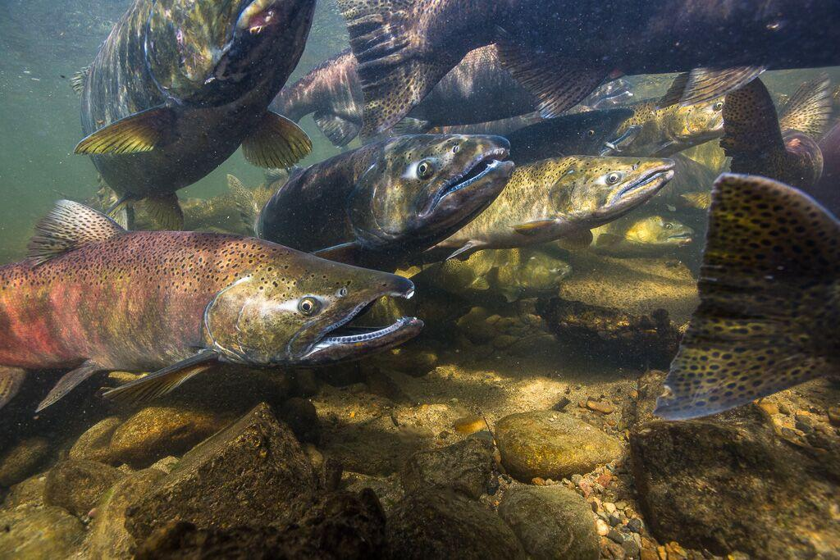
Salmon
Photo: Jess Newley
Notes:
The Southern Resident killer whales are here in the Salish Sea because of their food- salmon! 90% if their diet is Chinook Salmon.

Slide 6
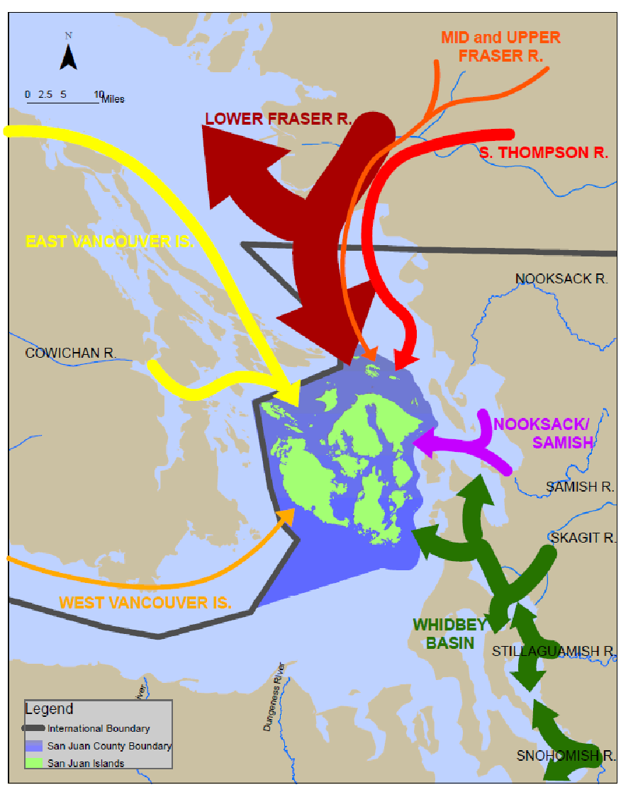
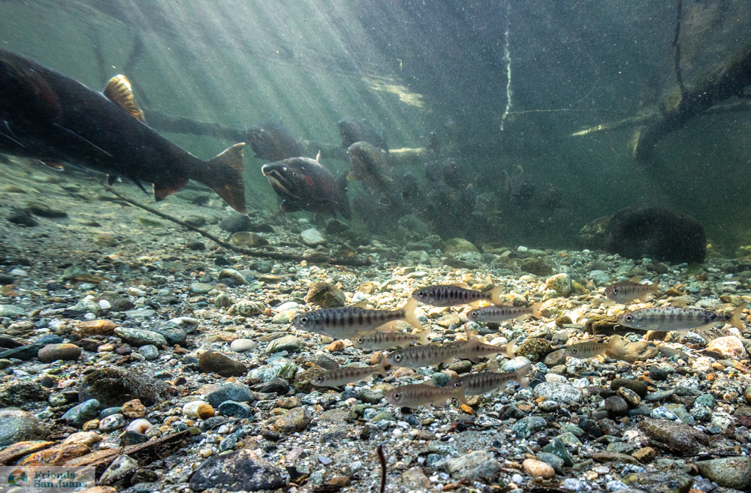
Juvenile salmon + rearing habitat
Rearing habitat for threatened Chinook/King salmon from across the region
(plus other salmon species!)
Photo: Jess Newley
Notes:
The shorelines of the San Juans Islands matter for more than local and visitors to the islands- this habitat supports juvenile salmon from around the Salish Sea. When they leave their natal rivers, before they head out to the Pacific Ocean, they make a stop along the shorelines of the islands to rear, or get big and strong. Juvenile salmon migrate to the shorelines to find shelter in habitat like eelgrass and bull kelp, where they can find their food source- forage fish.

Slide 7
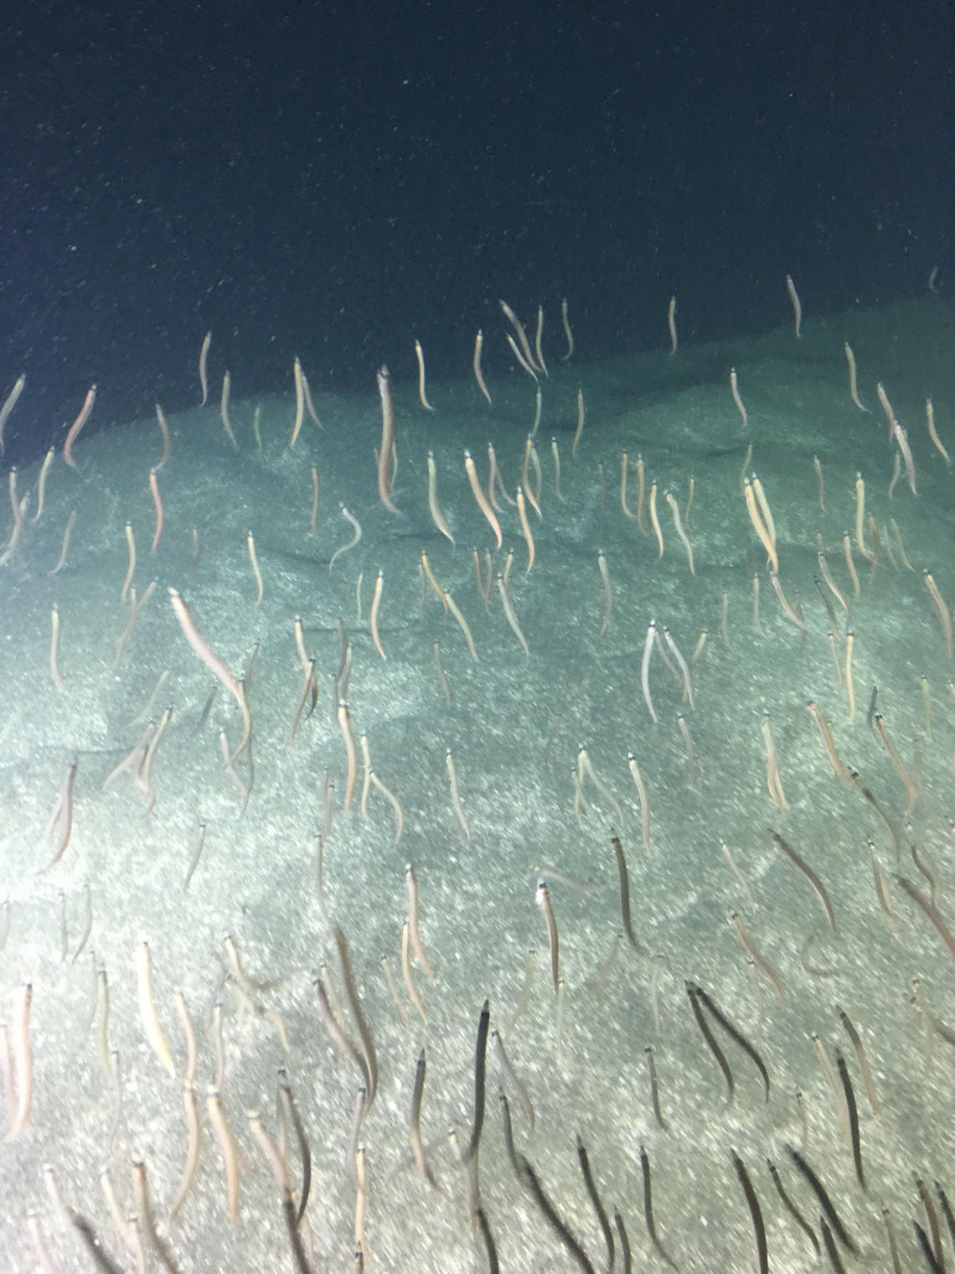
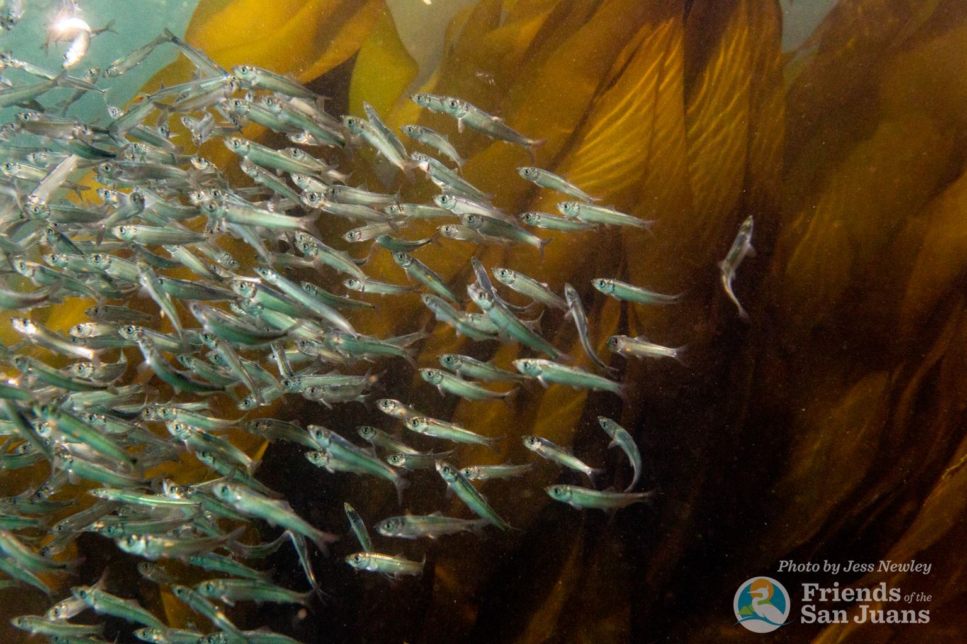
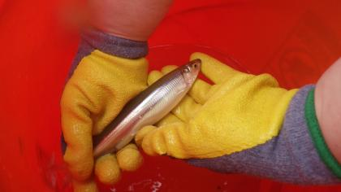
Forage fish or baitfish
Pacific Sand lance
Pacific herring
Photo: USGS
Photo: WDFW
Surf smelt
Photo: Jess Newley
Notes:
Forage fish are small schooling silver fish that everything from other fish to marine birds feed, or forage on! There are 3 main forage fish that salmon depend on for a rich source of protein. Pacific herring, Surf smelt, and Pacific Sand Lance.

Slide 8
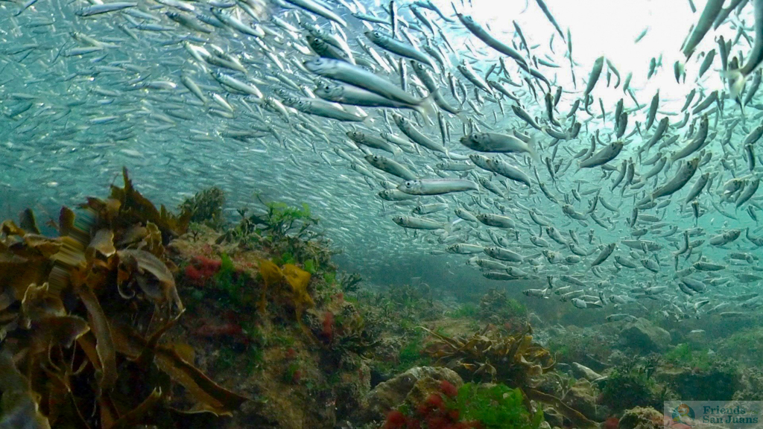
Andrew Reding
Pacific Herring
Photo: Jess Newley
Notes:
Pacific herring are important for many reasons- they have been a staple in the First People’s diet for over 12,000 years in the Salish Sea and many animals in the food web also depend on them. There use to be a robust herring population and now it is dwindling. Herring lay their eggs in the intertidal zone, on eelgrass and other underwater vegetation.

Slide 9
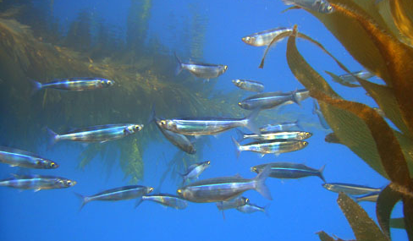
Surf smelt
Coastal watershed institute
Coastal watershed institute
Notes:
Surf smelt are another small school fish with a blue strip on them. They lay their eggs on the beach.

Slide 10
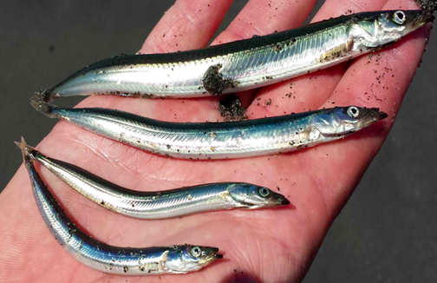
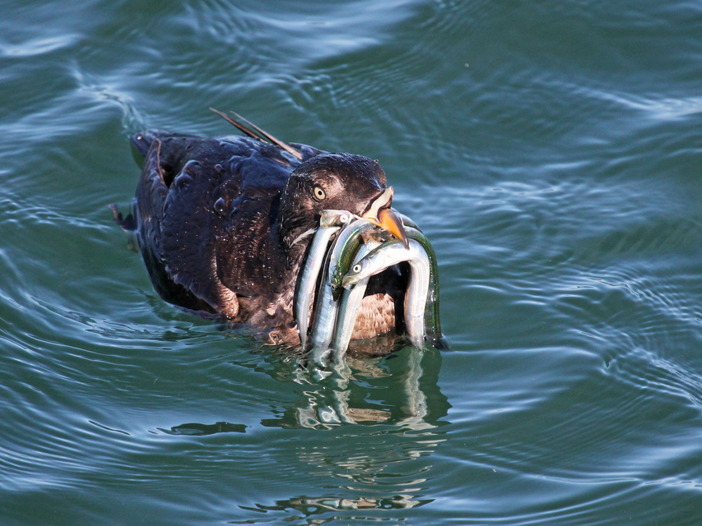
Andrew redding
ANDREW REDDING
NOAA
Pacific sand lance
Notes:
Sand Lance are the most important forage fish to juvenile salmon because they are the first fish, or protein they will eat. They are long and slender so can fit right into a salmon’s belly, even if it is barely larger than the sand lance! Marine birds like this Auklet fill up their beaks with them and take them back to the nests to feed their young.

Slide 11
Natural beaches!
Notes:
Sand Lance and Surf Smelt they their eggs on beaches, so they depend on us to keep beaches natural so they have spawning habitat. When the tide is high they swim up to the beach, disperse their eggs, or spawn, and then when the tide goes out, all the eggs fall on to the sandy substrate of the beach.

Slide 12
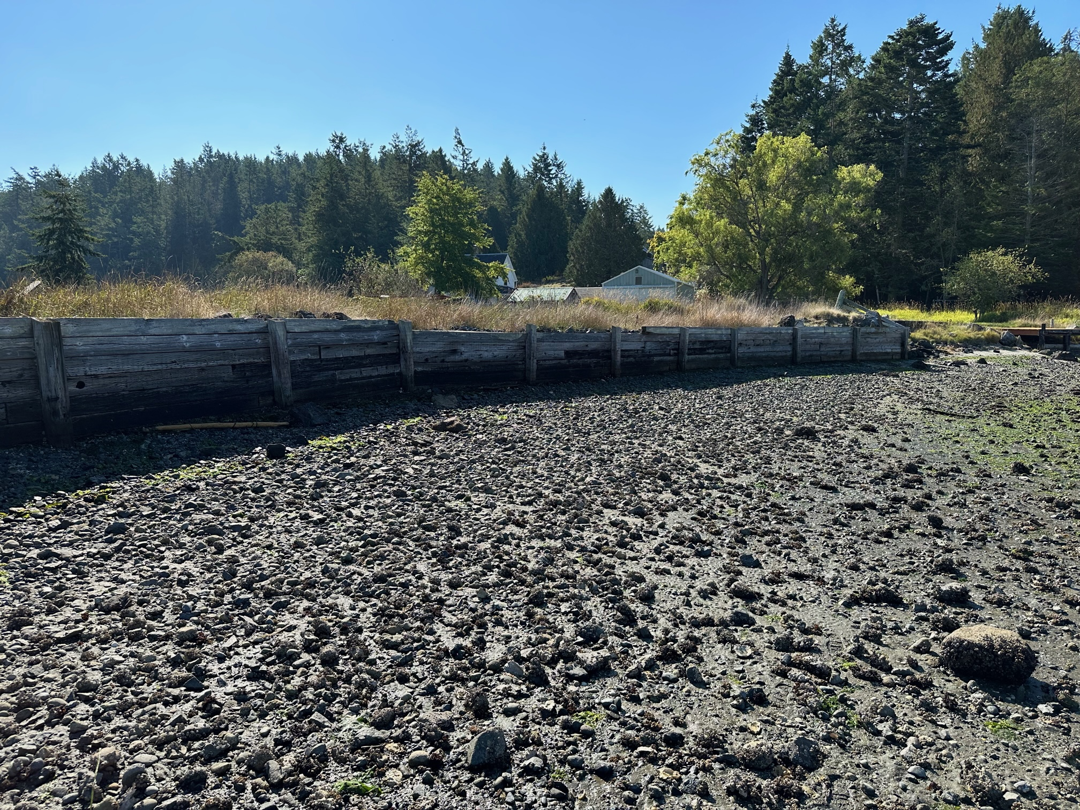
HARD ARMORING
Any hard armoring, bulkheads, seawalls, etc. ON the SHORELINE DISRUPT NATURAL PROCESS
Disturb spawning habitat for forage fish
Notes:
Hard armoring like retaining walls and bulkheads that are built on beaches to protect shoreline property disturb the natural processes of beach habitat that make them suitable for spawning.

Slide 13
Nearshore habitat
Photo: Jess Newley
Notes:
It is this nearshore habitat, where the sea meets land, that is critical for a healthy marine food web. Nearshore habitat is a highly productive area, and it is also where human activity can greatly affect marine life.

Slide 14
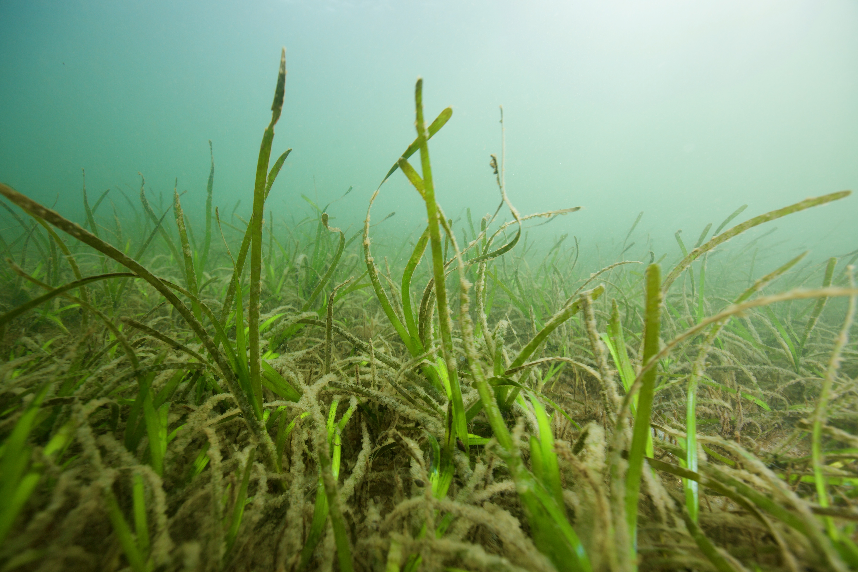
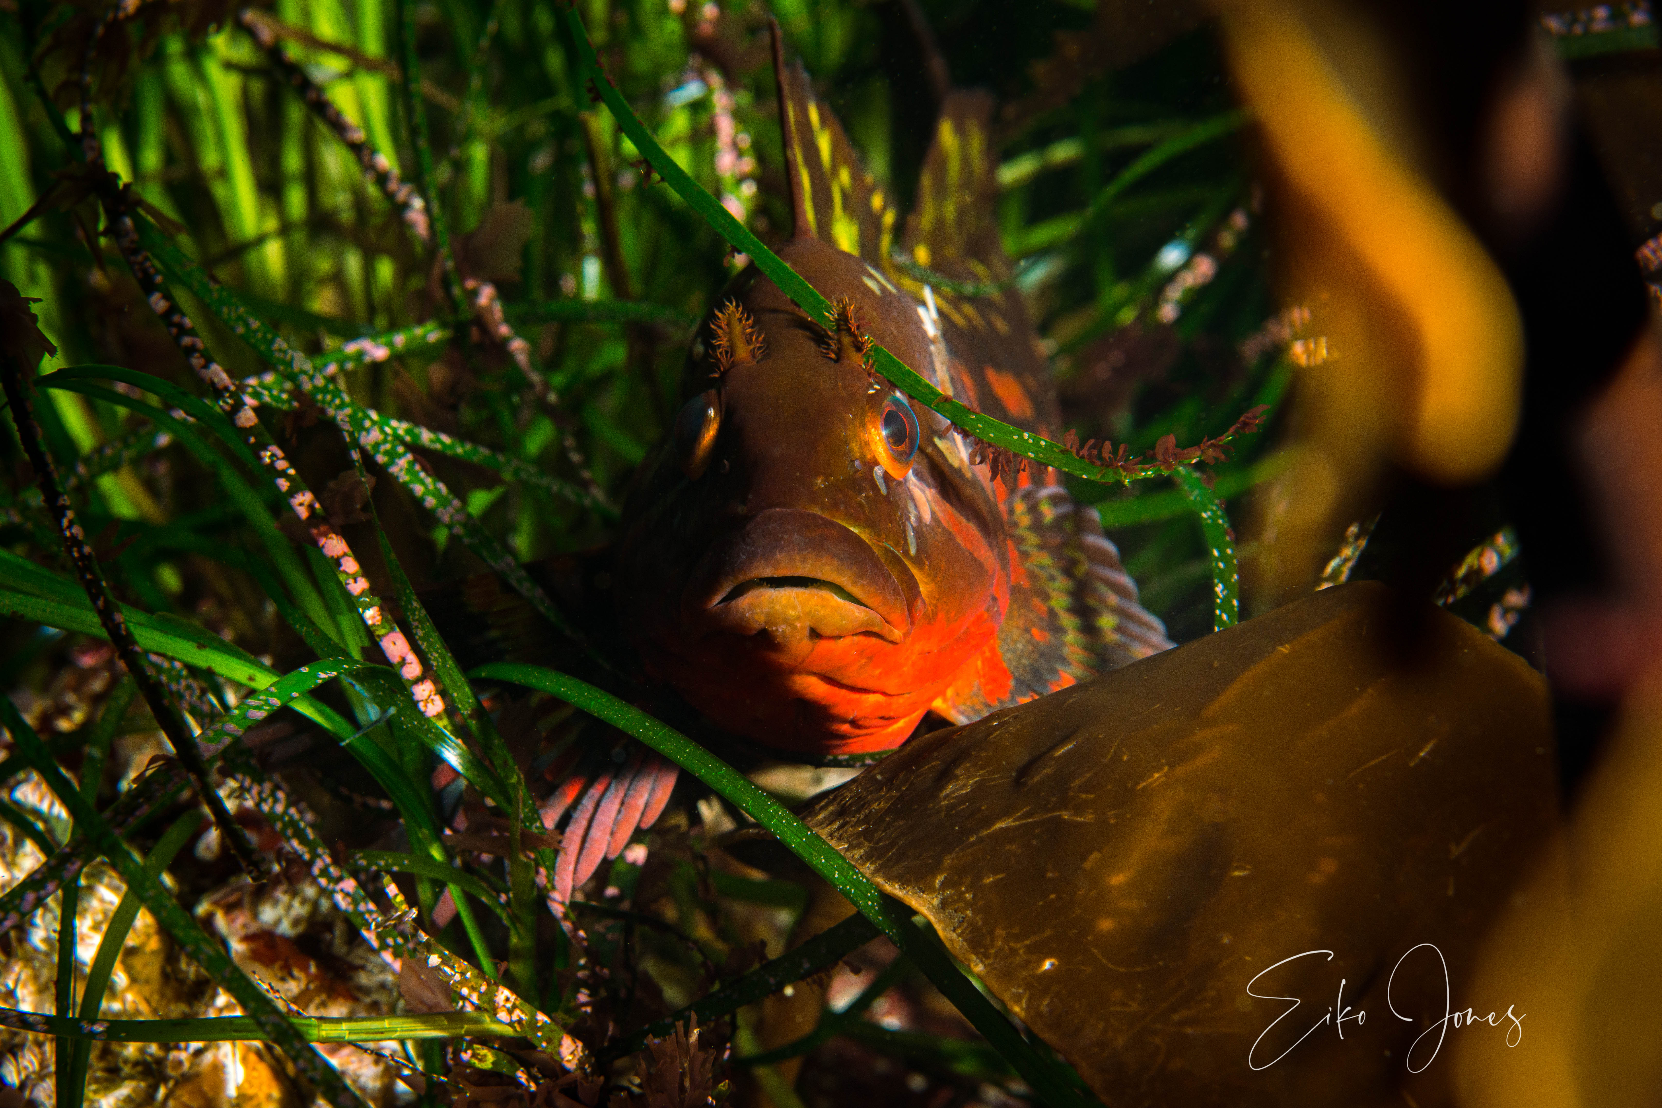
Eelgrass meadows
Photo: Jess Newley
Notes:
Shallow water 1-30 feet, light dependent
Sandy bottom
Flowering plant
Critical habitat for spawning herring to lay their eggs
Nursery, spawning, feeding & migratory habitat for large numbers of fish, crabs, clams
Highly productive
Stabilize soils & provide structure

Slide 15
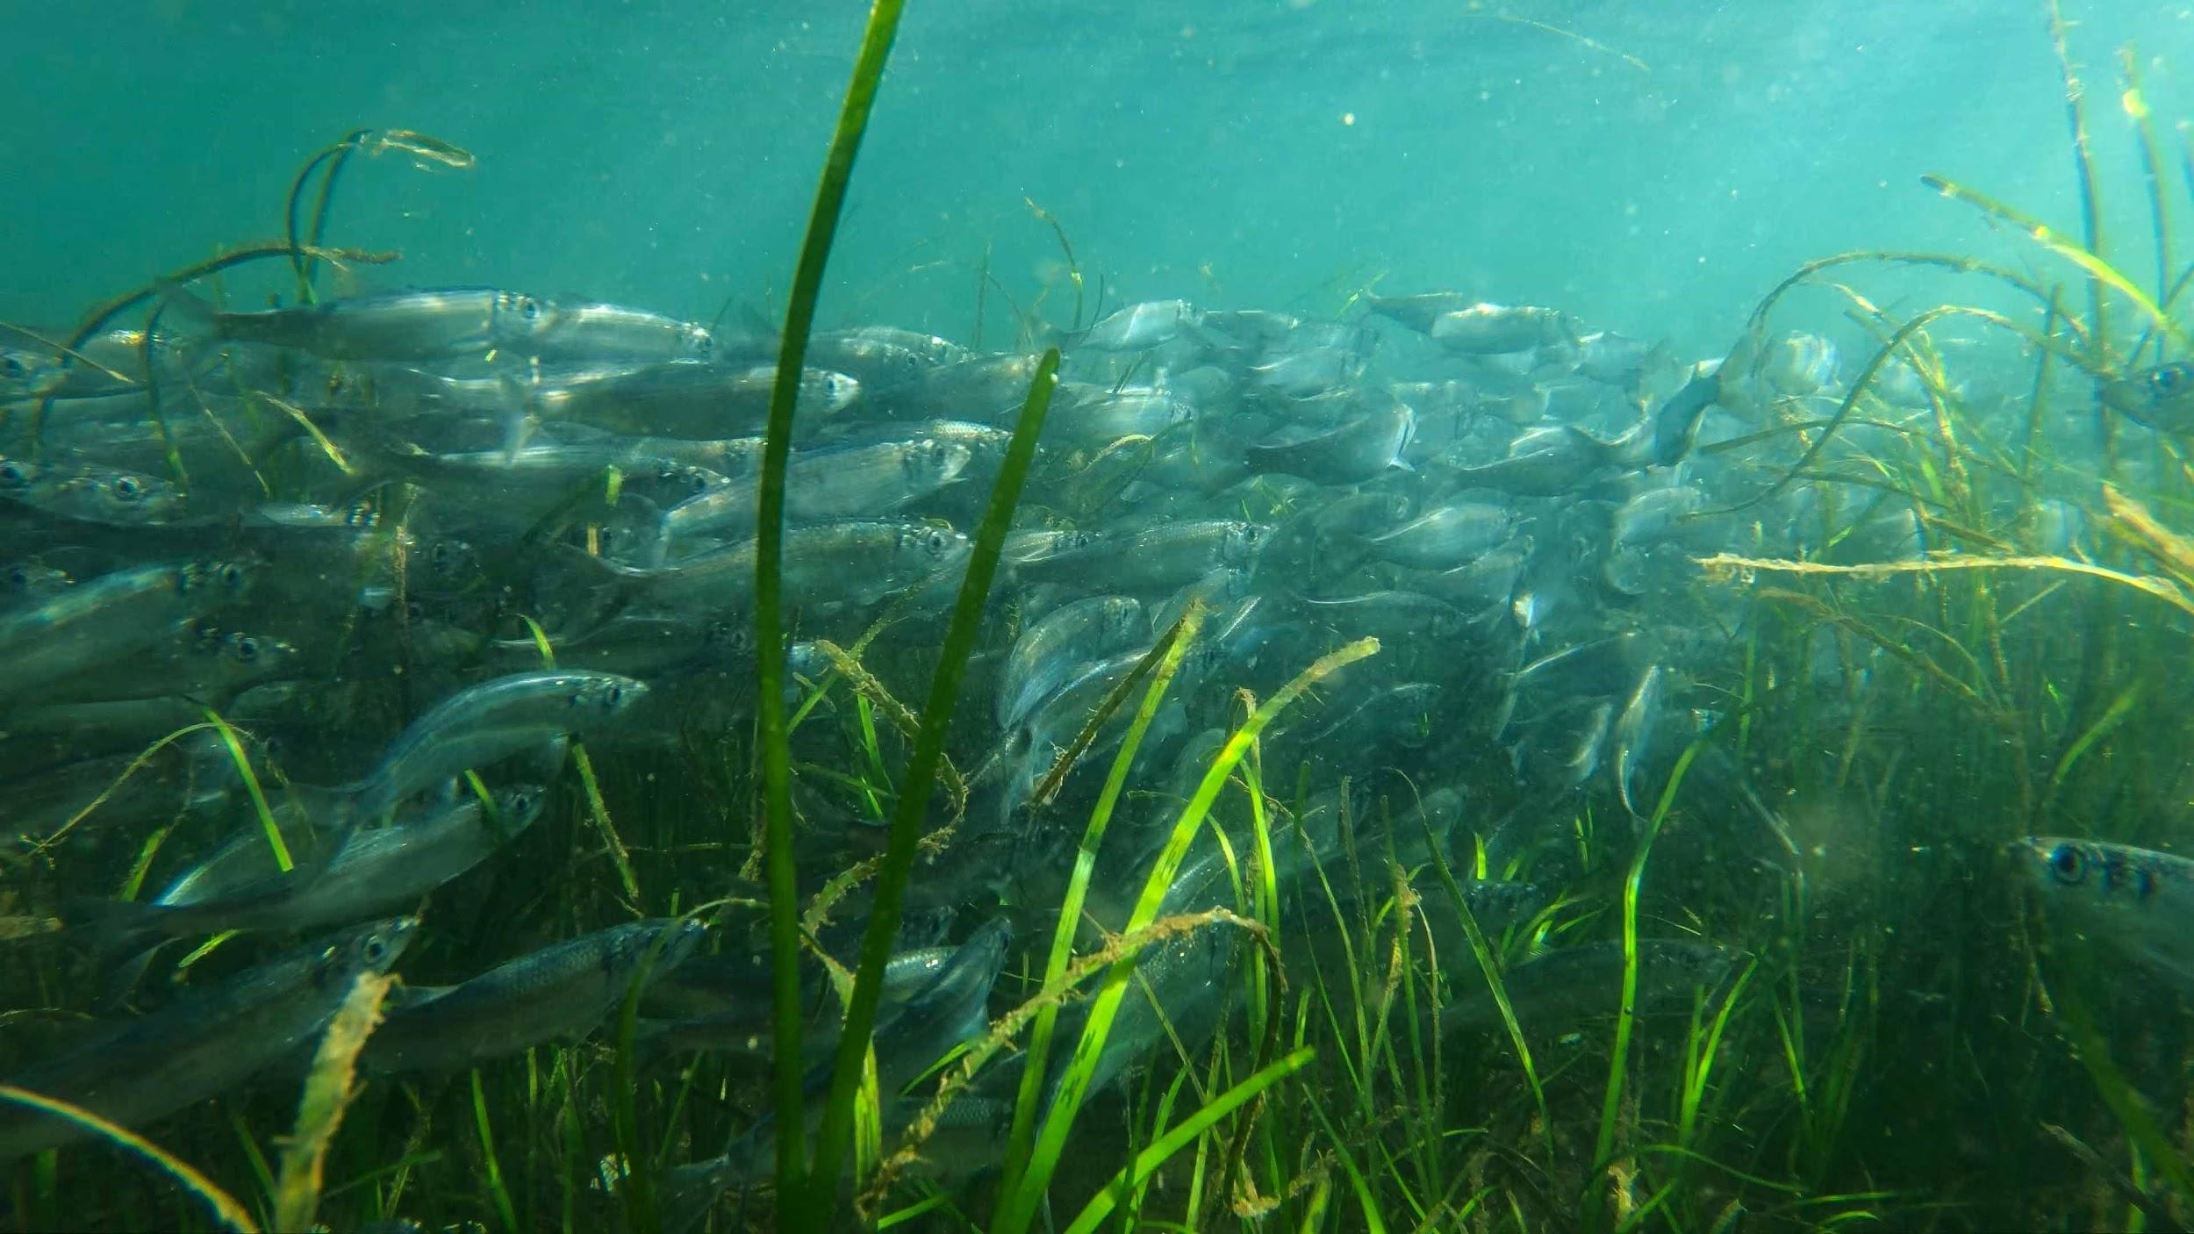
Pacific herring spawn on eelgrass
Photo: Florian Graner
Notes:
Herring depend on eelgrass to lay their eggs on.

Slide 16
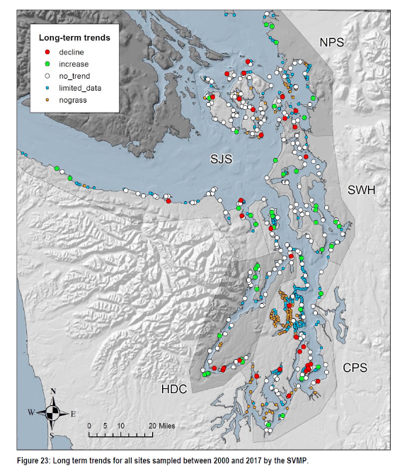
Eelgrass Habitat
On decline in many places
Pressures include:
Increasing water temps
disease
Docks
Boat anchors
Shoreline development
Notes:
Eelgrass is on the decline in many places around the Salish Sea. This map from the Department of Natural Resources shows where eelgrass is on the decline or increasing. Look where you are located, what do you see? Any ideas why it’s increasing or decreasing?

Slide 17
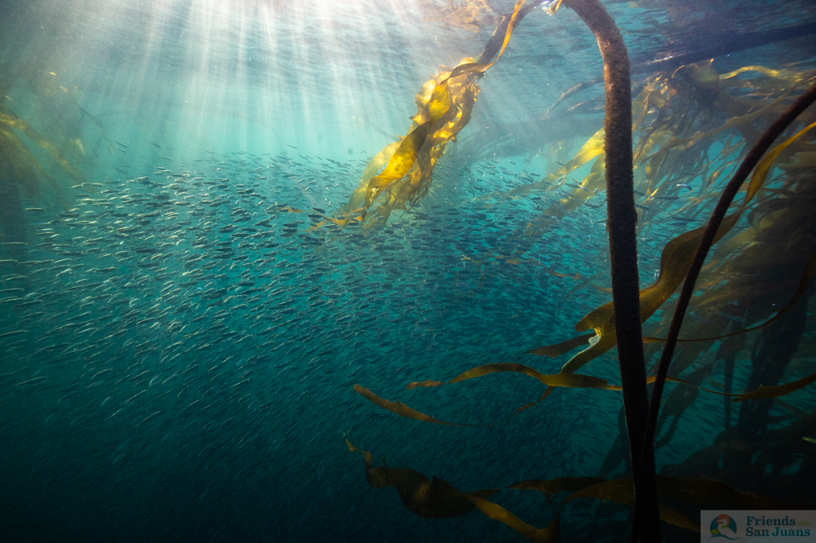
Bull kelp
Grows up to 2 feet a day
Place OF REFUGE, food & SHELTER FOR MANY INCLUDING HERRING &JUVENILE SALMON
PERMANTLY REMOVES CO2 FROM THE ATMOSPHERE (SEQUESTER 20 TIMES MORE CARBON PER ACRE THAN LAND FORESTS!)
Also on the decline in many places due to a variety of pressures
Photo: Jess Newley
Notes:
Bull kelp is another important or critical habitat for many species in the marine food web. It also provides refuge, food, and shelter for salmon, forage fish and many more. Some cool facts about Bull Kelp- it can grow u p to 2feet a day! Making it one of the fastest growing plant species, after bamboo. It also can sequester 20 times more carbon per acre than forests on land!

Slide 18
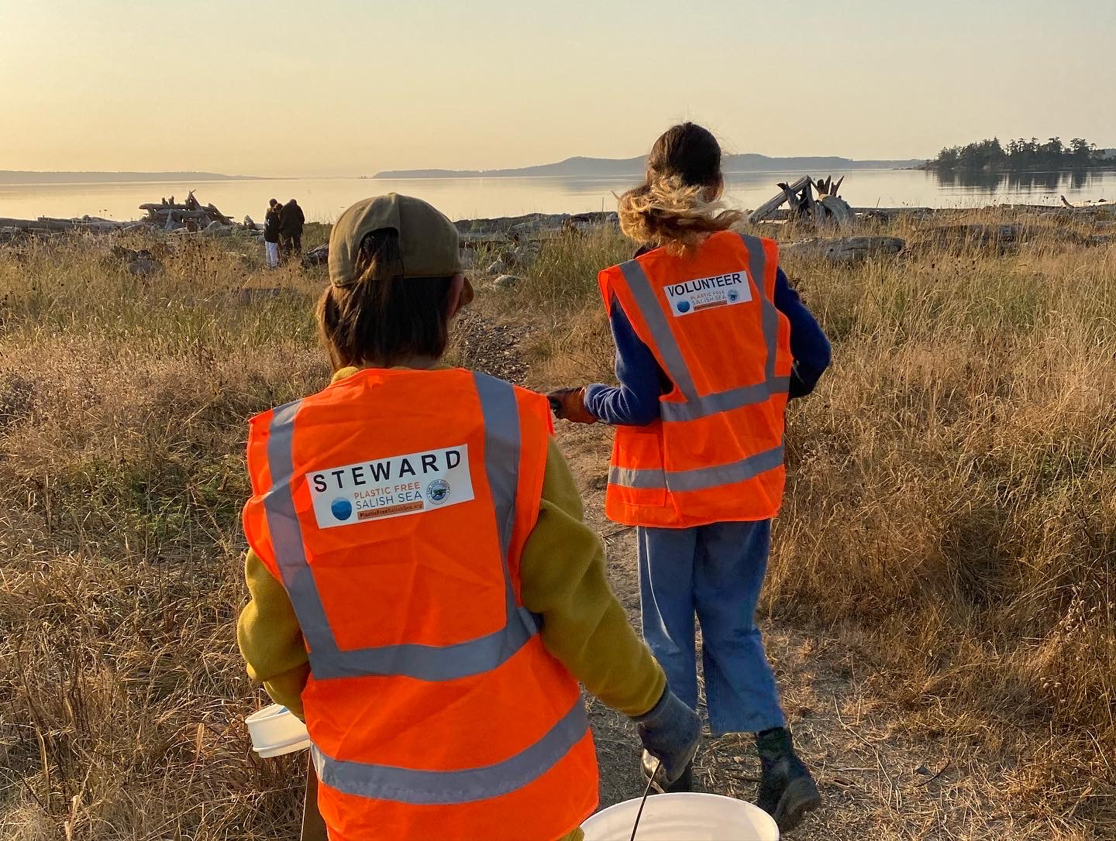
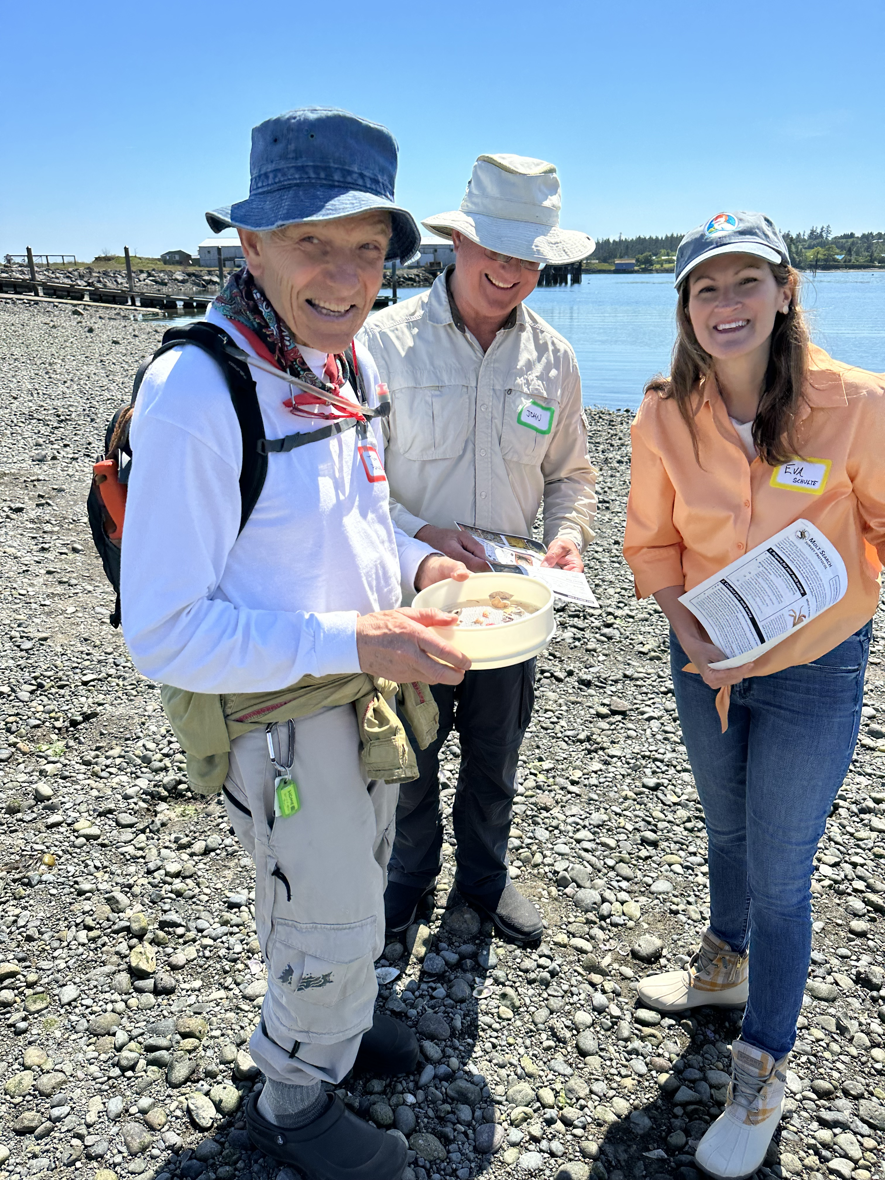
What can we do?!
Protect and restore critical habitat
for salmon and forage fish
Keep our beaches natural
Build a rain garden
Volunteer
Tree planting
Beach clean ups
Community science
Stay engaged And use your voice!
Notes:
While there are many pressures on our marine environment, there are many things we can do to help!

